Slide 1
Step by Step NLP: From Data to Deployment
How to Build and Deploy a Chatbot by: Greg Loughnane

Slide 2
Outline
About me
On Chatbots
On NLP MVPs
💸 The Problem
🤖Data + Model
🌐 Web App
☁️ Into the Cloud
Notes:
Who am I?
Why chatbots?
What business problem might we solve?

Slide 3
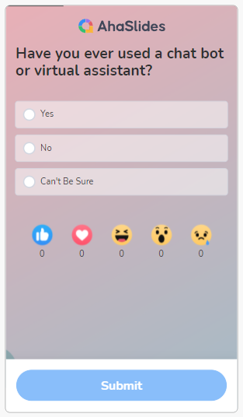
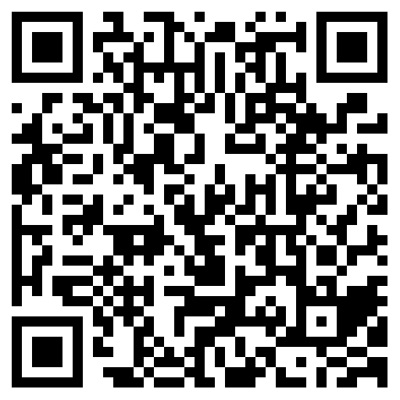
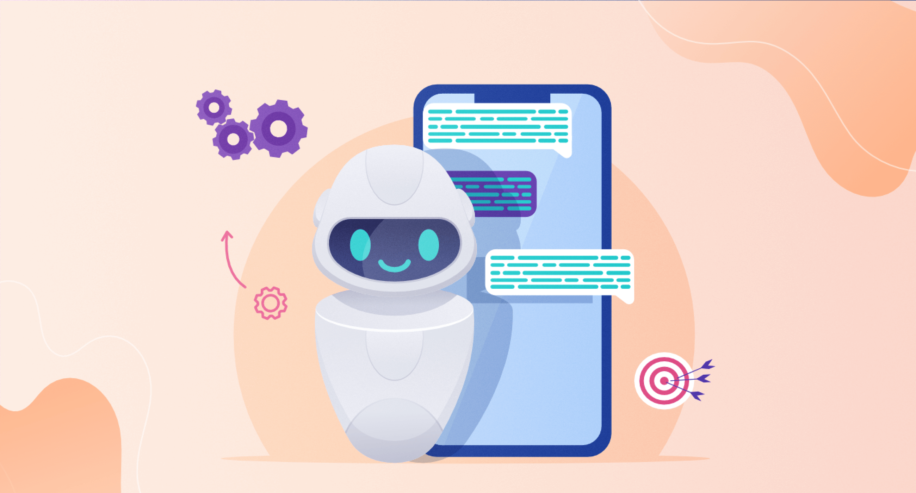
Have you ever used a chatbot?
ahaslides.com/DLAIBOT

Slide 4
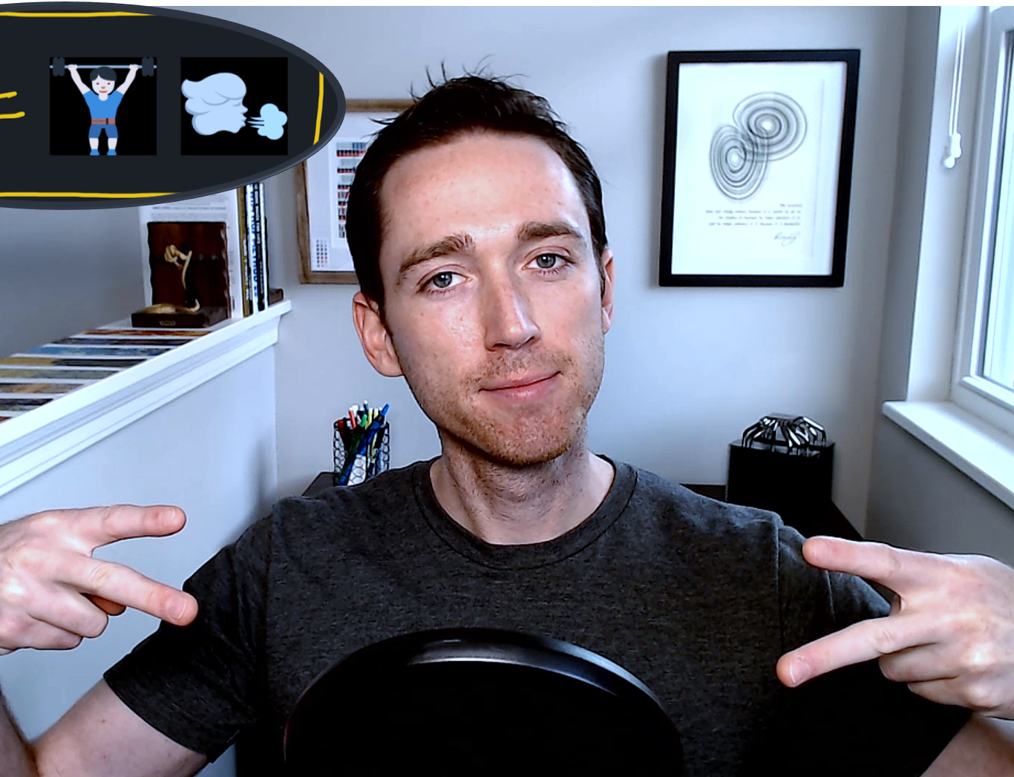
🚪 Proper Intro
Cape Cod, MA ⛵
Dayton, Ohio 🛩️
‘06-’11: Mechanical 🛠️
Environmental 🌳
Design 🦋
‘11-’14: Materials 🔬*
Academia 🏫
Defense 🛡️
Manufacturing 🏭
‘14-’19: Optimization 🍥
Biomedical ⚕️
ML/AI 🤖
Consulting 📃
‘20+: Entrepreneurship 👨‍💻
Startups 🦄
San Francisco, CA 🌉
7-min version of my professional story on YouTube
Notes:
Unless you’re into defense contracting, or moving incredibly slow, Dayton has been a rough place to be.
‘07 – daughter was born
’17 – realized I had never read any of the great books
‘21 – realized I had never experienced any of the greatest paintings
The common thread – I’ve been teaching since 2011 through today, for 10 years. My favorite thing about teaching is learning.
My strategic learning journey continues through today and will likely continue until my dying days.
At each step, I’ve realized how futile much of my knowledge gained actually is, and I’ve done my best to refine the things that I tell my students about what’s worth knowing and what really matters.
A lot of times in higher ed people want to talk about matter other materialist myopia, and don’t get me wrong I enjoy nerding out on that too, but I’m much more concerned with what matters.
I’ve finally run out of space left in the mediums that I’ve taught in to focus solely on what matters, and so I’m doing it myself.
What matters is embracing your humanity, your creativity, and your humanity in the 21st century.
Don’t compete with computers and don’t compete with machines.
Learn how to use them for leverage.
Over and over.
This is what I believe we should all be doing.
This is what I believe will make us #Unautomatable.

Slide 5
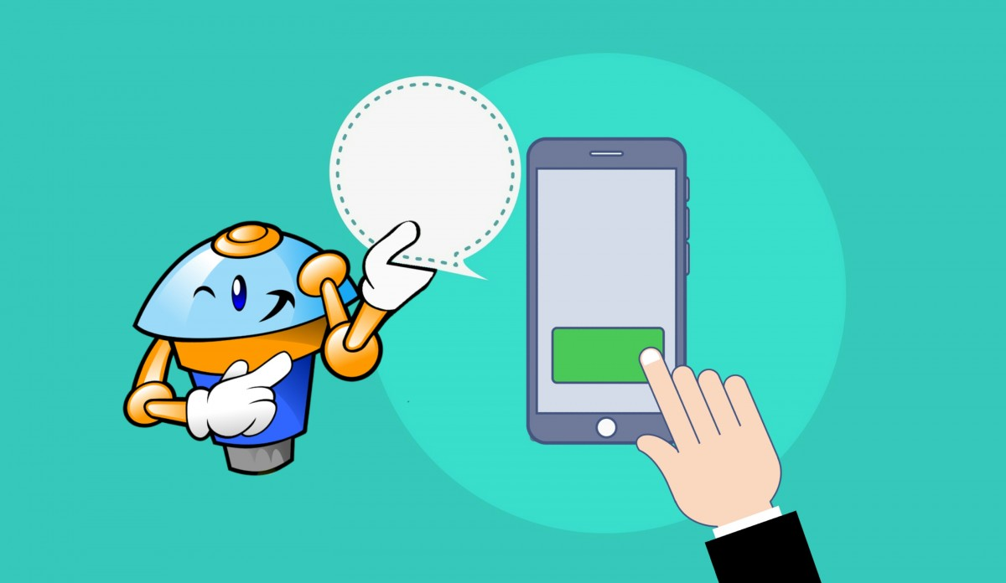
Chatbot Applications
“Over the next decade … AI assistants [will become] the primary channel through which people get information, goods and services …”
… and marketing will turn into a battle for their attention.”
🏡 🚗 📱
“Marketing in the age of Alexa” by Niraj Dawar, 2019
Notes:
Over the next decade, as [firms] fight to establish the preferred consumer AI platform, AI assistants will transform how companies connect with their customers. They’ll become the primary channel through which people get information, goods and services, and marketing will turn into a battle for their attention.
Once the dust settles, we expect that just a handful of general-purpose AI platforms will be left standing. Most consumers will use only one, whose assistant will be incorporated into their homes, cars, and mobile devices.

Slide 6
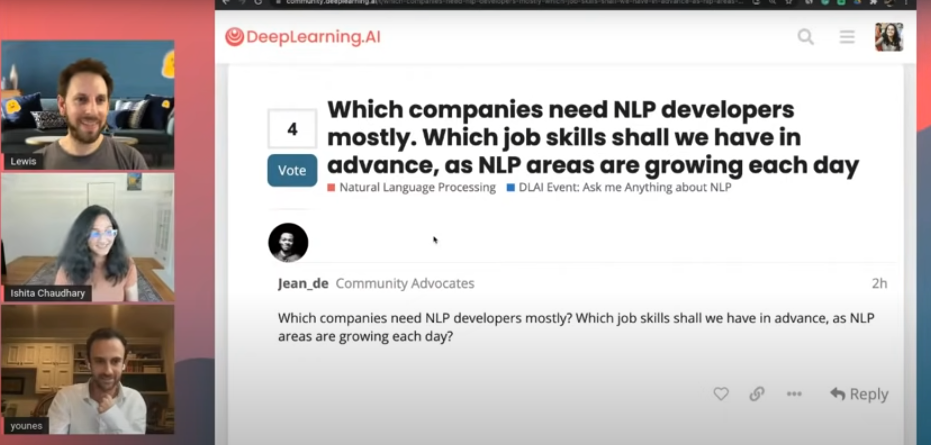

On NLP Tech in Products
“We use text in business for everything.” ~ Lewis Tunstall
Notes:
There was also a question asked a few weeks back about how much needs to be known about NLP to create a service like grammarly?
The short answer is that a lot needs to be known, but you probably don’t need nearly as much NLP knowledge as you might think.
To create any digital product or service, we really need to go from zero to one on the digital product that our models are serving up to our users and customers, and while machine learning algorithms can certainly be part of that, they’re nested in the larger backend and frontend pieces. Today is meant to give some insight into those pieces.

Slide 7


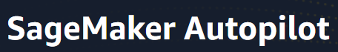
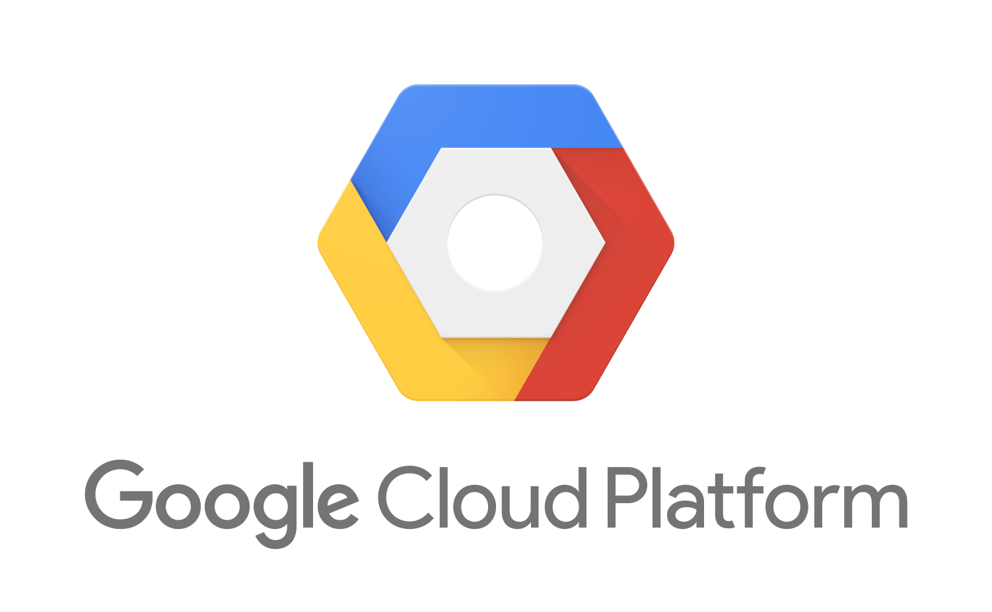

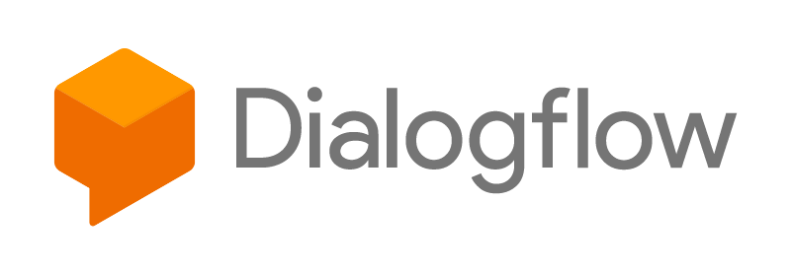


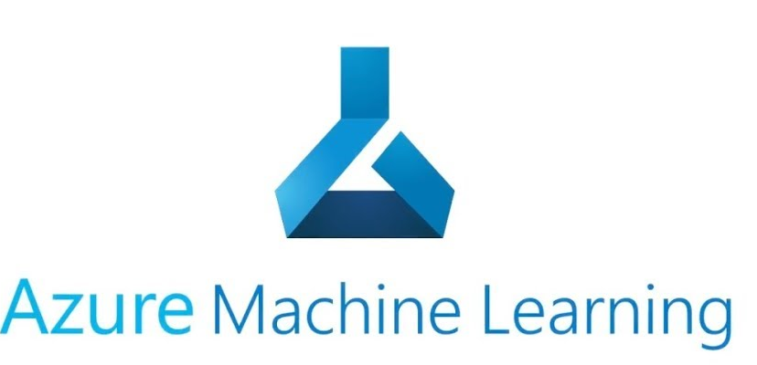
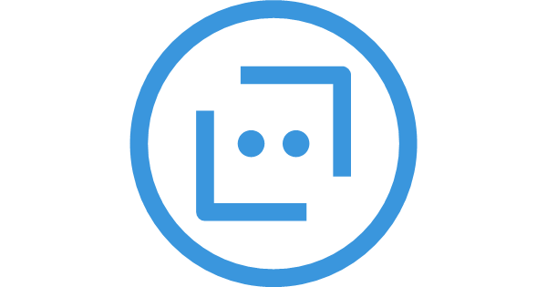

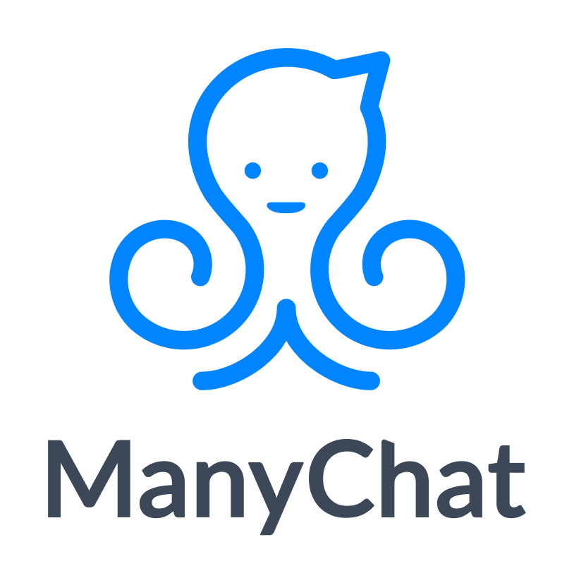
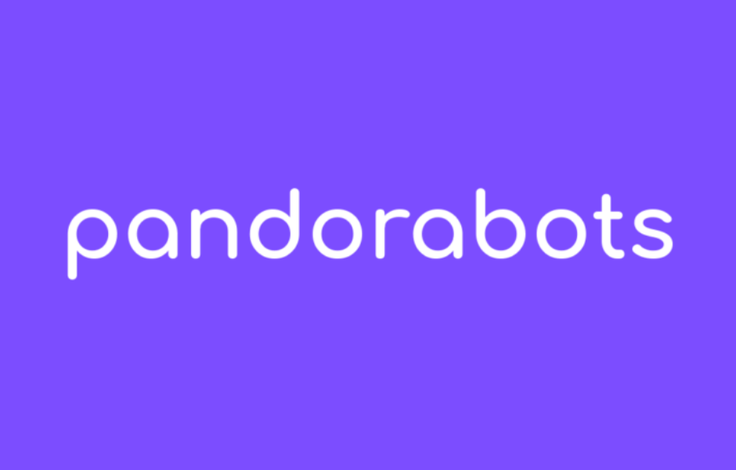
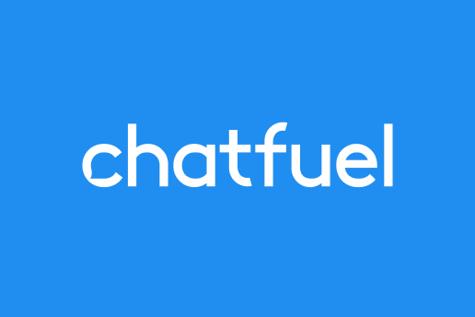



NLP MVPs
Minimal Viable Prototype/Product?
Enterprise products
End-to-end product lifecycle (MLOps)
Measure
Learn
Build
Notes:
Amazon: from AWS to Sagemaker to Sagemaker AutoPilot to Amazon Lex
Google: From GCP to AutoML to AutoML Text, Translation to Dialogflow
Microsoft: From Azure to Azure ML to Azure Bot Service to Azure Power Virtual Agents
We’re moving from customer service to far beyond – HR, Sales, and “any channel or domain imaginable today”
Even players like Hubspot and SAP are getting in the game through acquisitions to deliver no-code chatbot solutions
“Cheap changes everything” from Prediction Machines, Ajay Agrawal

Slide 8
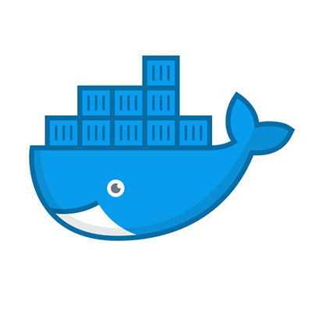


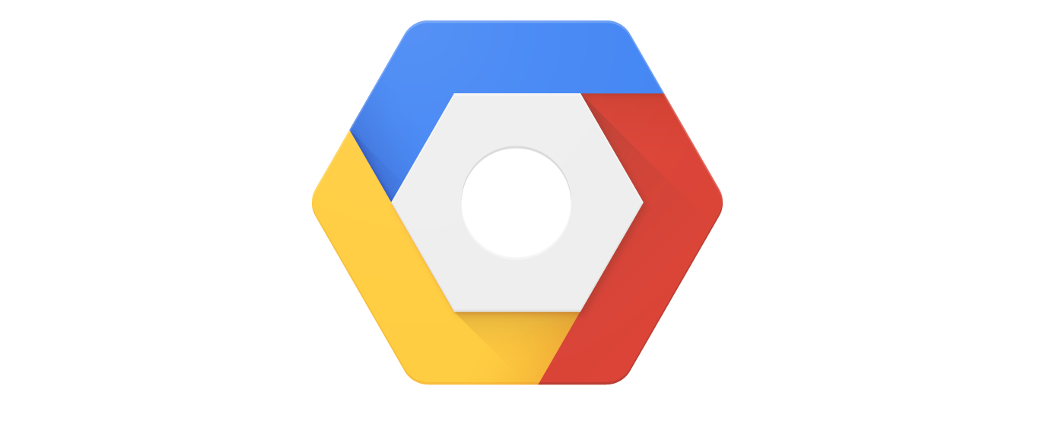
Let’s Build an MVP!

Slide 9
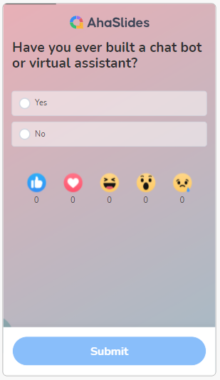
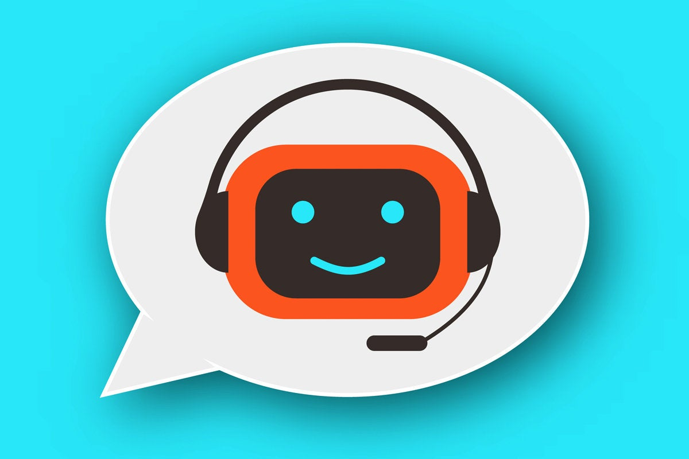
Have you ever BUILT a chatbot?
ahaslides.com/DLAIBOT

Slide 10


Slide 11
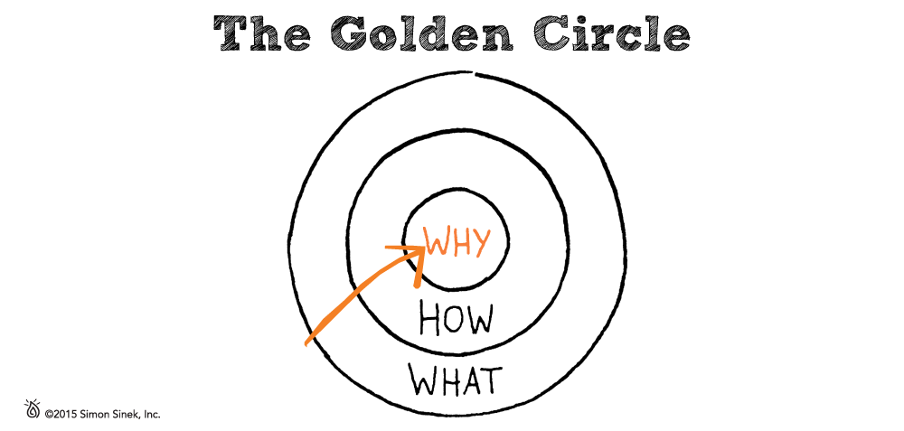

Slide 12
💸 The Problem 🤖Data + Model 🌐 Web App ☁️ Into the Cloud

Slide 13
Once Upon a Time…

Slide 14
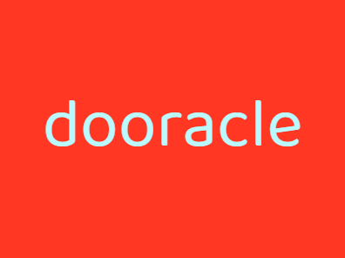

Meet Paige
PM @ Dooracle
Service → SaaS
⚗️
🃏️
Notes:
Dooracle is a company that’s trying to revolutionize the fortune telling industry
So far they’ve developed a solid fortune telling services business
They’ve got a WebApp and software infrastructure that customers and fortune tellers can use to connect with one another.
However, until they can show investors that this service model is scalable, they will never be able to raise Series A.
In short; they’re trying to move from a Services Company to a SaaS Company or a “Product Led” company.
This will allow them to keep up with the Jones’ and to show their investors that they understand what it will take to become masters of scale.

Slide 15
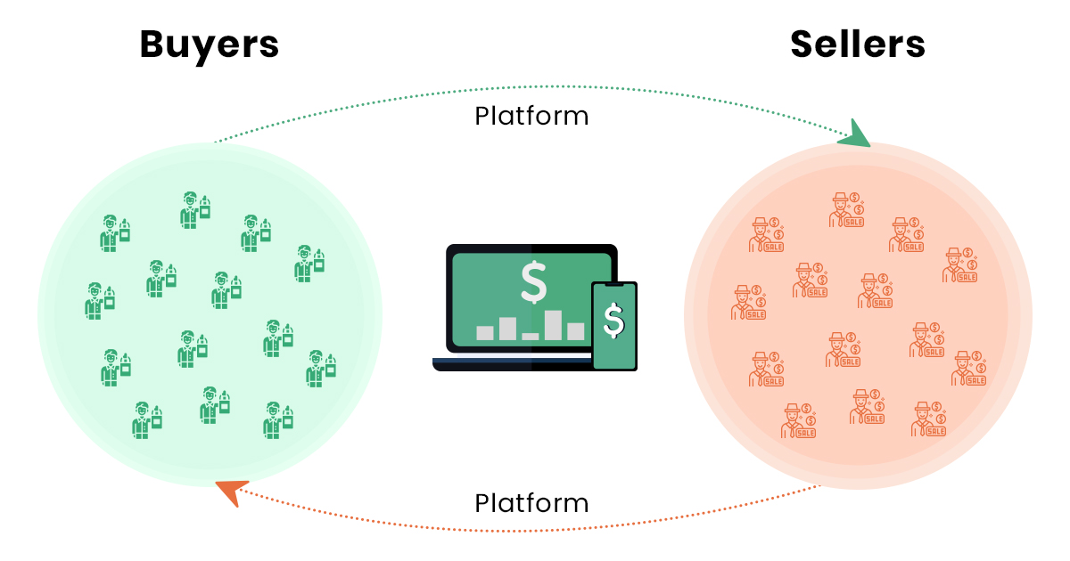
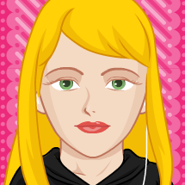
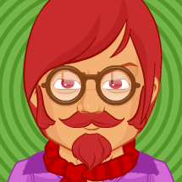


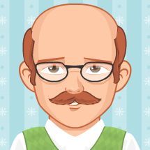

Automation Projects
Information gathering
🌙 AI Psychic
Fortune Seekers
Psychics
Notes:
One of the best ways to show investors that they’re going to be the company to revolutionize this industry is to prove out their ability to produce real value and to think big with ML/AI-first products
The first order of business is to automate the most repetitive information tasks that sales representatives are doing routinely with psychics on both sides of the platform.
This will be done with a simple rule-based algorithm that aligns with the questions sales reps already ask psychics and fortune tellers today.
The plan is to run it the first iteration in shadow mode,
Once our team can move through AI assistance and partial automation steps, we will launch a fully automated version that removes humans from the loop, and frees up our sales stuff to focus on higher-value customer success activities
But we’ve also got a top secret moonshot project – where we’re actually going to try to build out an AI psychic and test it with some early adopters on both sides of our platform
If we can position our product to leverage transfer learning from the superintelligent AI that we hear is just around the corner, maybe we actually will be able to predict fortunes soon…

Slide 16
The Problem
Based on proprietary Dooracle analysis, there are not enough fortune tellers to fill global consumer demand.

Slide 17
💸 The Problem 🤖Data + Model 🌐 Web App ☁️ Into the Cloud

Slide 18
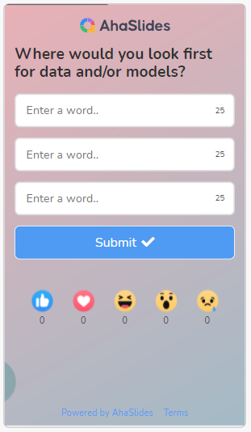
Where to look for data + models?
ahaslides.com/DLAIBOT

Slide 19

Resources for Building Your Chatbot
YouTube
Step by Step NLP: Data to Deployment
GitHub
https://github.com/FourthBrain/step-by-step-nlp-dialogpt-chatbot

Slide 20

Meet Jay
Data Scientist @ Dooracle
🤔 … 🤗
⚗️
🃏️
Notes:
If all goes well and this is something that the VP Product wants in our FY22 roadmap, maybe we can finally justify hiring that full-time MLE or MLOps engineer in 2022 to support Vinay across projects, including this moonshot.

Slide 21


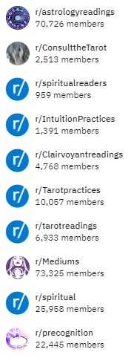
Mimicking our Psychics
Largest psychic community forum on Reddit (196k)
Additionally…

Slide 22
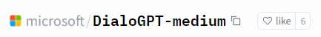
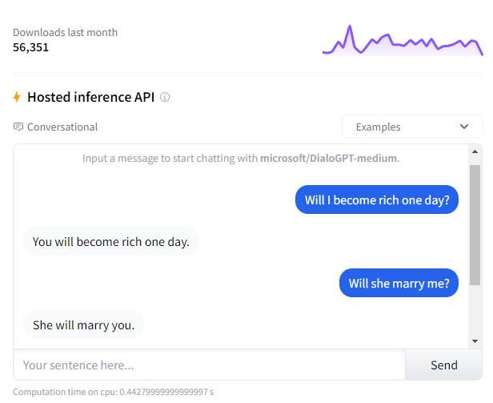
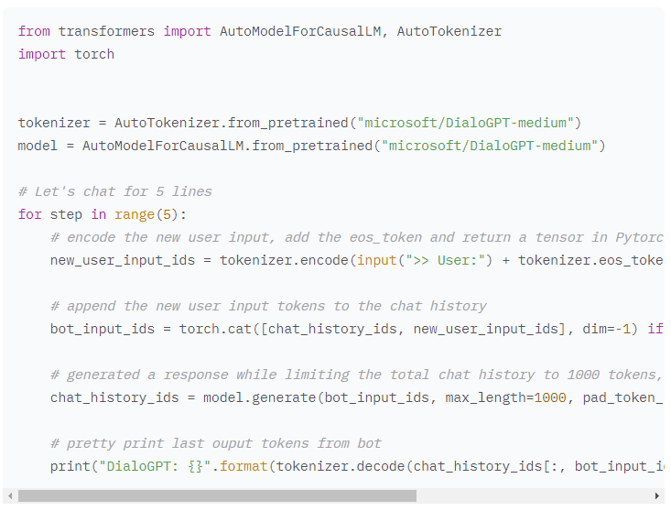

DialoGPT
Trained on 147M multi-turn dialogue from Reddit discussion thread
Only a few lines of code to implement!
Notes:
Jay tells you that DialoGPT is a state-of-the-art large-scale pretrained dialogue response generation model for multiturn conversations.
The human evaluation results indicate that the response generated from DialoGPT is comparable to human response quality under a single-turn conversation Turing test.
Vinay says he tested it with some off-the-wall questions too, and he can sense the Reddit humor. Although we’ll have to retrain the model to truly flavor it just the way we like it, and this will be expensive (just downloading the full reddit submission and comments dumps, as well as creating intermediate files required to generate the structured 27 GB dataset would require 700 GB of local disk space and a full 1-2 days), out of the box the model looks like it will work pretty well for some early user testing.
At the end of the day, it seems like it will be a perfect fit for our customers.

Slide 23
Data + Model
147M multi-turn dialogue from Reddit
Pretrained model from Transformers Library

Slide 24
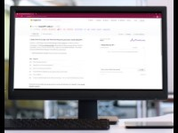
https://youtu.be/VHMBDBdwTY0

Slide 25
💸 The Problem 🤖Data + Model 🌐 Web App ☁️ Into the Cloud

Slide 26
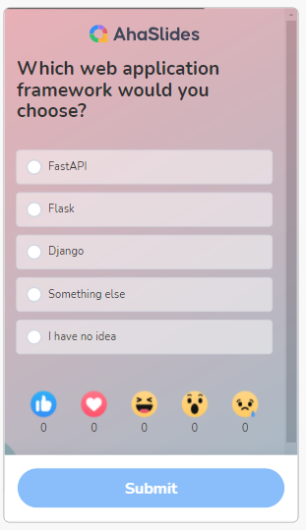
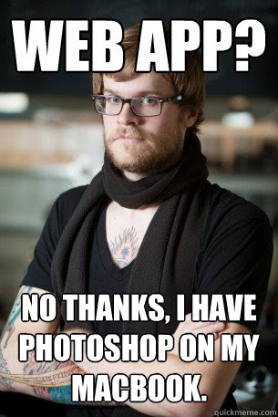
ahaslides.com/DLAIBOT
Notes:
Vinay threw out a couple…

Slide 27

Meet Brent
Software Engineer @ Dooracle
Jay says he thinks “Flask?”
⚗️
🃏️
The Brent Effect
Notes:
Brent is software engineer – does front end, back end, and everything in between. A true DevOps savant
He doesn’t really “believe” in ML or AI. He feels like it’s all hype, and is only interested in picking up tools if they happen to the be the best possible ones for the job.
He’s really not a fan of this new buzzword either that he keeps hearing – MLOps.
He aims at becoming and indisepensible member of any team he joins. A true “Brent,” he’s not all about spending time teaching people what he knows. He’d rather just get after it and make things happen

Slide 28
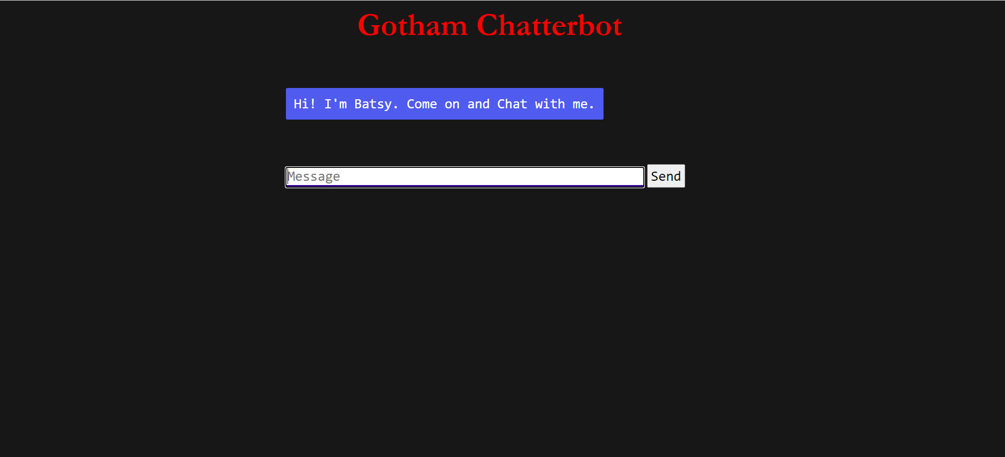
https://github.com/bhargavramdr/Gotham-chatbot

Slide 29
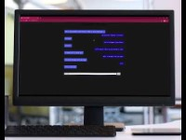
https://youtu.be/JRAIZeZ7IfA

Slide 30
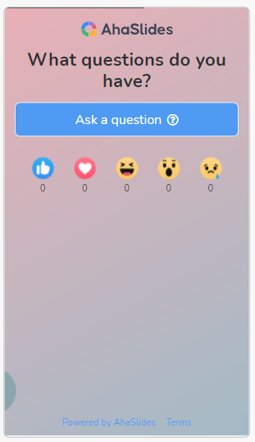
What questions do you have?
ahaslides.com/DLAIBOT

Slide 31
Jay and Brent
“Nice! Did you say you going to use Docker to deploy the webapp?”
“Can you show me please?!”
“Yeah, we’ll use containers images.”
“Download Docker Desktop and I’ll show you how to do it on your computer.”

Slide 32
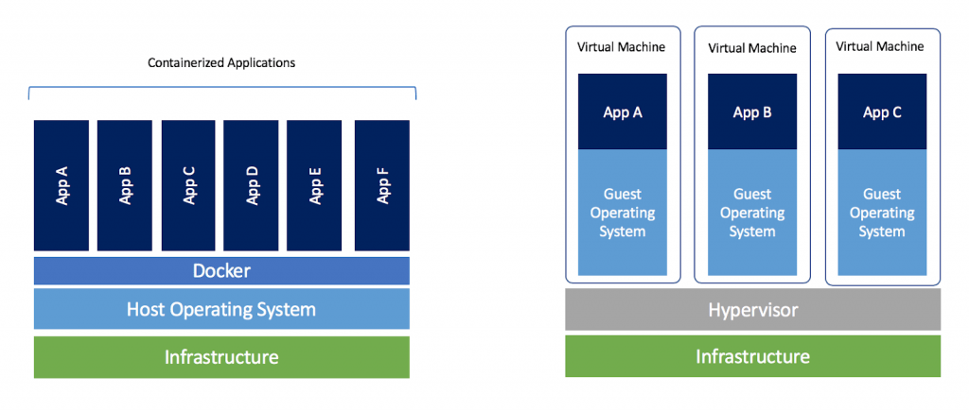
From Virtual Machines to Containers
Brent
“Remember how you had to set up chattyvm from the ground up with python, pip, git, your NLP libraries, and all of that?”
Jay
“For sure, and we did all that in Ubuntu on WSL2”
Brent
“Exactly. So we’ll effectively use chattyvm as our operating system to deploy containers locally.”
Jay
“Sounds imple enough. So are you saying that we’ll actually put our container(s) inside of chattyvm?”
Brent
“Right, just like any other computer. I’ll show you.
Credit: docker blog

Slide 33
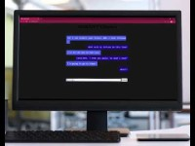
https://youtu.be/Bl0fRQ5_XqA

Slide 34
💸 The Problem 🤖Data + Model 🌐 Web App ☁️ Into the Cloud

Slide 35
From Virtual Machines to Containers
Brent
“Remember how you had to set up chattyvm from the ground up with python, pip, git, your NLP libraries, and all of that?”
Jay
“For sure, and we did all that in Ubuntu on WSL2”
Brent
“Exactly. So we’ll effectively use chattyvm as our operating system to deploy containers locally.”
Jay
“Sounds imple enough. So are you saying that we’ll actually put our container(s) inside of chattyvm?”
Brent
“Right, just like any other computer. I’ll show you. But then we’ll ditch chattyvm, create a new vm in the cloud, download and install everything we need there.
Jay:
Then Paige will have a public link to test with customers!
Credit: docker blog

Slide 36
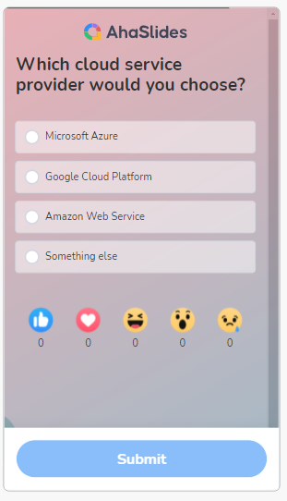
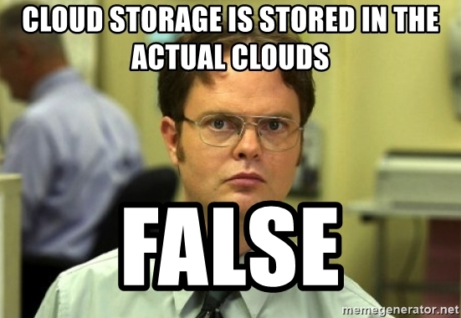
ahaslides.com/DLAIBOT
Notes:
Vinay threw out a couple…

Slide 37
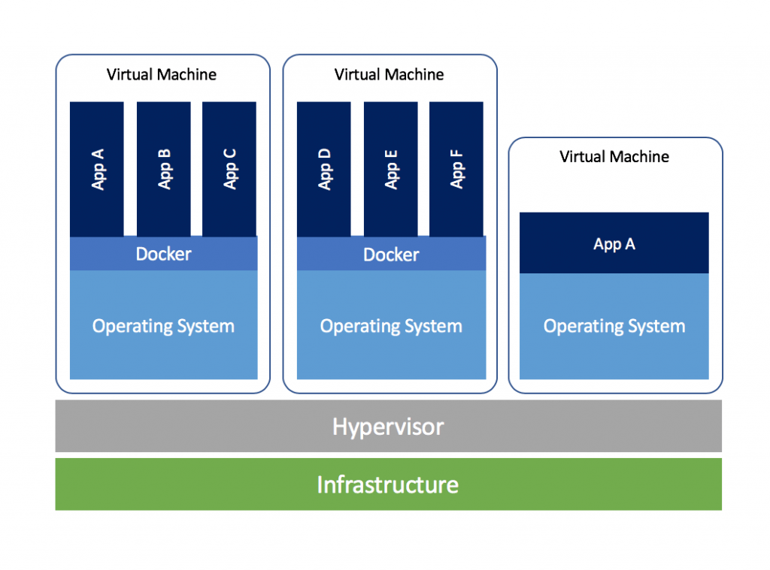
VMs, Containers, and the Cloud
Brent
“Dooracle uses Google Cloud Platform for a lot of stuff, and since I have an account set up already, we’ll use that. But it’s basically the same everywhere.”
Jay
“OK, let me get this straight: we’re going to create a virtual machine in the cloud, which has its own operating system.”
Brent
“Correct.”
Jay
“And in that host OS we’re going to leverage docker to create a containerized application by building a remote container image?”
Brent
“You’re starting to sound like a developer.”
Credit: docker blog
Notes:
“It’s not really about containers OR VMs.”
“It’s containers AND VMs”
That’s because public cloud environments rarely dedicate entire servers to one application
Generally, recommend ho

Slide 38
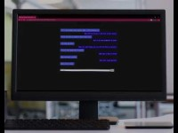
https://youtu.be/jPfQv8hh_pw

Slide 39
A Product, Data Science, and Software Success!
“Hey Paige – check it out! Built and shipped!”
“This is awesome guys – so fast! Give me a few days to start some customer development activities. Feedback coming soon!”

Slide 40
As Jay and Brent Leave Work…
I hope users don’t ask questions that are too hard…
I hope that only a few users ping this thing at a time…

Slide 41
The Next Day
“That’s it for the AI Psychic for now… follow-up with the dev lead on the Info Gathering team for next steps!”
“Sure Paige…”
Notes:
“I’ll bring you back in once the AI Psychic has some movement. Over there they’re not building something brand new, so no ground-up prototypes needed!”
They’re you're working on something that exists! So go see how you can help them look at the data that exists, investigate technical debt, and try to figure out how to make iterative improvement to KPIs that flow up to business objectives
“Maybe I should’ve taken more time for the stuff I actually like…totally could’ve spent some time researching the fortune telling domain to train custom embeddings … … … she’ll be back.”

Slide 42
One month later…

Slide 43
Dooracle gets a $50M Series A

Slide 44
And their adventures…

Slide 45

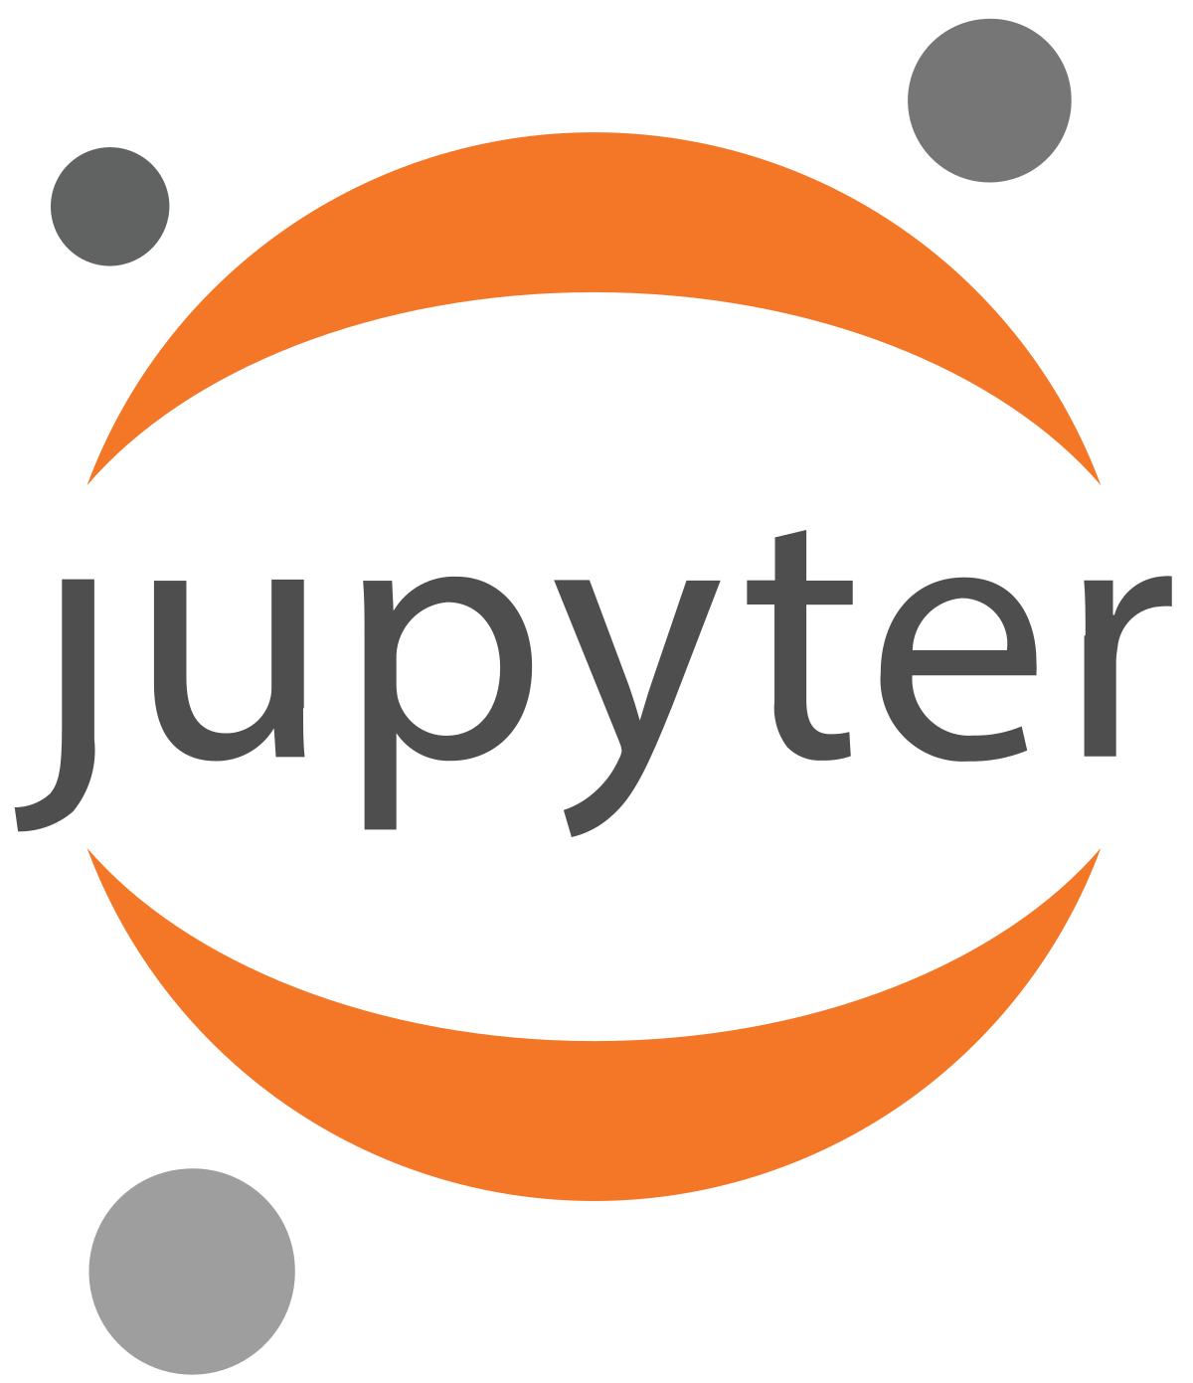
From Data to Deployment ☺

Slide 46


And beyond…

Slide 47
Continue…

Slide 48

Resources for Building Your DialoGPT Chatbot
YouTube
Step by Step NLP: Data to Deployment
GitHub
https://github.com/FourthBrain/step-by-step-nlp-dialogpt-chatbot
Hugging Face
https://huggingface.co/microsoft/DialoGPT-medium

Slide 49
Thanks!
Reach out anytime!
📧 greg@fourthbrain.ai
🔗 linkedin.com/in/gregloughnane/
🐦@GregOnLock

Slide 50
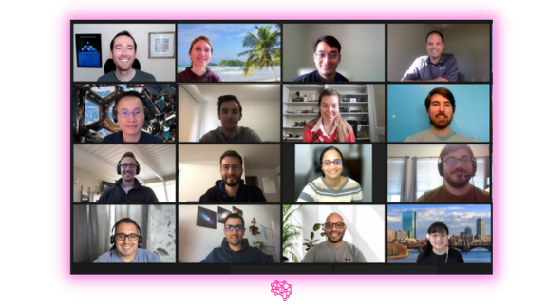
Next MLOps Cohort Starts 2/26!
12-weeks + 💎 Capstone
Deploy & Test 0 to 1
Scale & Manage 1 to N
Monitor pipelines and infrastructure
🏫 www.fourthbrain.ai/dl-scholarship

Slide 51
What questions do you have?
ahaslides.com/DLAIBOT

